Slide 1
Grimsby Institute Group
“How are post-secondary institutions in the UK involved in the roll out of the fish and shellfish certification, diploma and apprenticeship proficiency qualifications?”

Slide 2
Aims
Develop opportunities within local market
Meet the sector skills demands and needs
The Lincolnshire produces/processes over 12% of the UK’s food supply including more than 70% of its seafood and 25% of its vegetables; the sector employs more than 68,000 people across the supply chain with a diverse mix of businesses and a wide range of primary producers
5,000 people employed in NE Lincolnshire food sector, excluding 4,000 employed in the logistics sector.
Estimated one third of local population employed in food or food related roles.
The food chain is estimated to generate a GVA of over £2.5bn and employs 56,000 people in the area.
If food retail and catering are included the figures rise to £3.4bn of GVA and over 100,000 jobs.
Source: GLLEP 2014

Slide 3
Who are we?
Four Educational Operations
Grimsby Institute Group
University Centre Grimsby
Yorkshire Coast College, Scarborough
Lincolnshire Regional College, Skegness
Commercial Business Units
Food Technical & Operational Management
Food Refrigeration and Process Engineering Research Centre
East Coast Occupational Safety and Health
Workforce Skills
Engineering, Business, IT & Management

Slide 4
Interview with Mat Thompson

Slide 5
Sector Offer
Professional Services, Apprenticeship’s & Degree’s
Research Consultancy & Advice
Training & Professionally Recognised Courses
Training Needs Assessment and Management
Providing innovation and technical skills and research to business - Internet of Things - Cold Chain - Sustainability - Automation

Slide 8
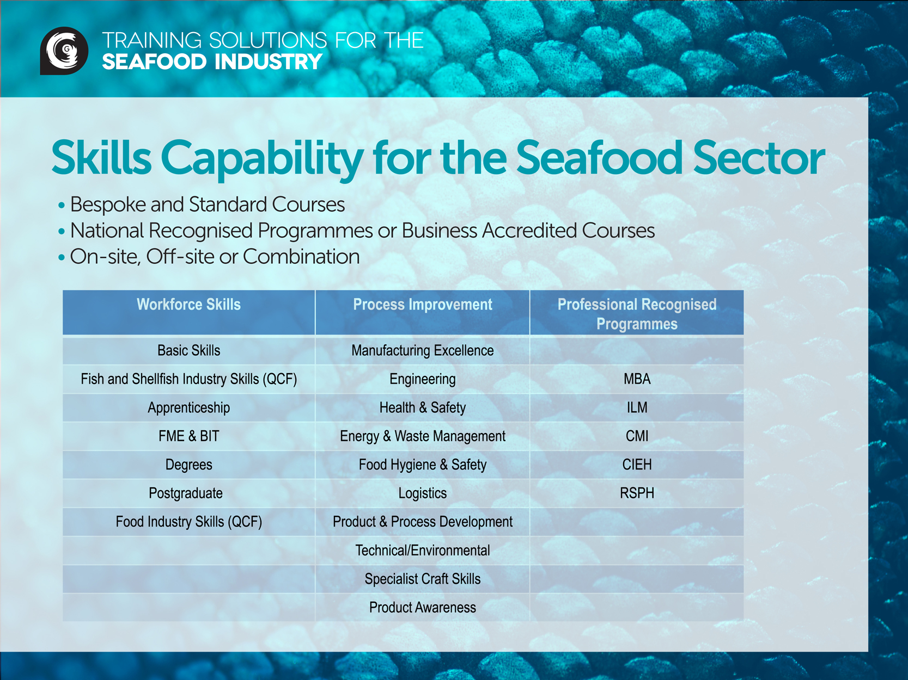

Slide 9
Progression Pathway
Talent
Value Added Consultancy, Research & Education alongside
Degree
Foundation Degree
Value Skills, Growth & Capability for Local Workforce & Competitiveness
Higher Apprenticeships
Apprenticeships

Slide 10
Benefits
Delivery of focused support - make improvement - up skill and grow future talent
Management Development - create talent and capability - nurture future operators, leaders and managers
“To become skills makers, rather than skills takers.”
“for the sector to attract Talent and Grow It’s Own”

