Slide 1
What’s happening in the UK?
How do fish and shellfish qualifications meet the needs of industry?
Notes:
Lee Cooper, Seafish and the Seafood Training Academy email academy@seafish.co.uk

Slide 2
What’s happening in the UK?
Background
History of qualifications, Level of take-up, size of the industry.
Why things are better now?
Fish and Shellfish Industry Skills Qualifications

Slide 3
Background – early VQs
Vocational qualifications in the UK
SVQs in fish processing, early 1990s
Food and drink manufacturing operations N/SVQs, mid-late 1990s
Seafood processing N/SVQs, early 2000s
Improve Ltd launch their Strategy for recognising Achievement in 2007
“The birth of proficiency qualifications in food and drink”
Notes:
Vocational qualifications based on national occupational standards began in the UK in the early 1990s.
Initial qualifications were fish specific and highly prescriptive.
Next came generic food manufacturing operations vocational qualifications that required adaption to fit into fish and shellfish.
The third generation of seafood VQs included more fish specific content for fish processors, but like the two versions before them they never really caught on except for a few larger processing companies.
Version 4 – the fish and shellfish industry skills IPQs were the first set of qualifications that seemed to address the needs of the industry.

Slide 4
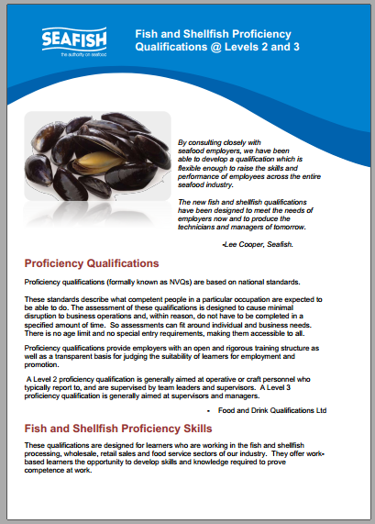
Background – fish and shellfish
2011 : Completed L2 framework.
2013 : Completed L3 framework
2012/13 – 1st fish and shellfish apprenticeships piloted
Only 3 providers active in 2013.
Notes:
459 over 2 years. 566 in 1 year.
Grimsby Institute, Lakes College and NEFTS
See http://seafoodacademy.org/Topics/5Topics%20Apprenticeship%20Providers.htm for full list

Slide 5
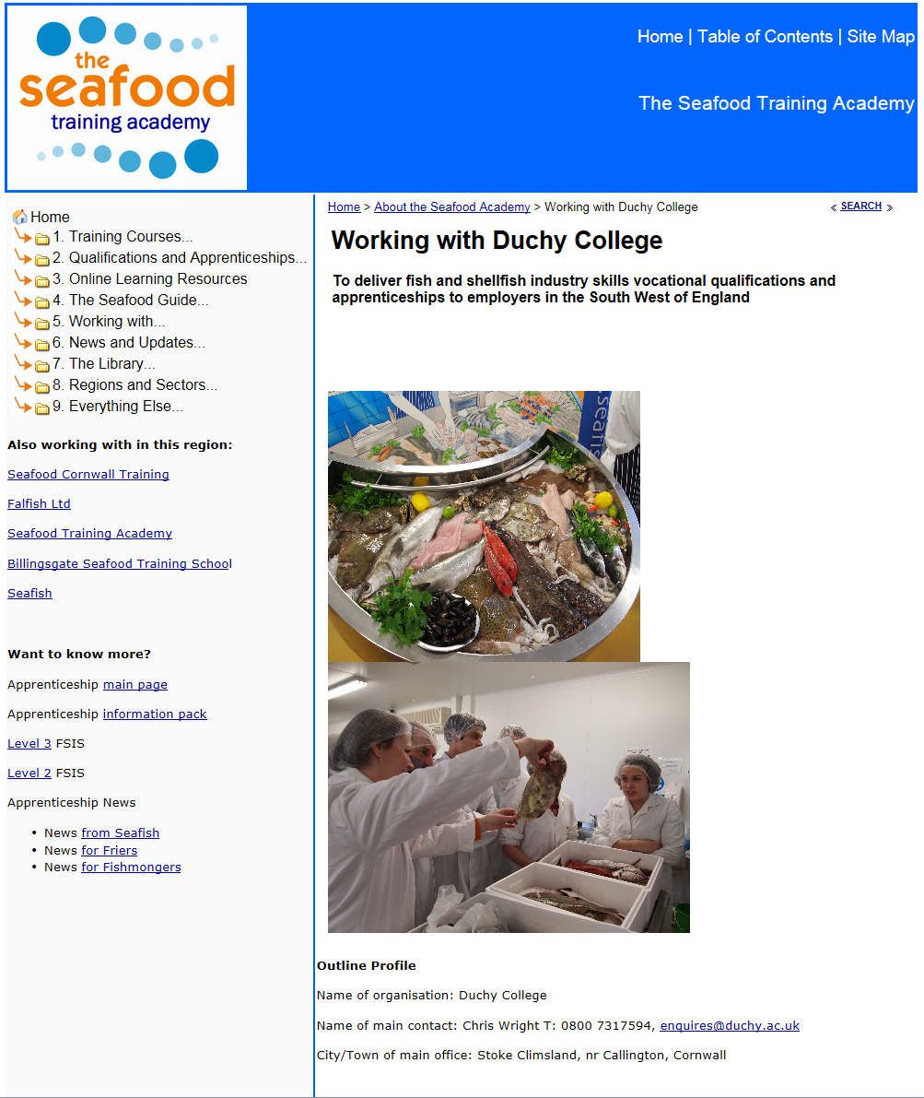
Background
Building the Network
2013 1st recognition
2016 14th recognition.
11 New starts.
Notes:
Duchy College was the first new provider to be recognised by Seafish.

Slide 6
Take up
2013 + 2014
less than 460 registrations over 2 years
2015/16
more than 560 registrations in 1 year
Notes:
Approx. 50% of apprenticeships are delivered to medium sized fish processors, 40% to small friers and mongers, 10% to large fishmongers (Supermarkets)

Slide 7
Size of the industry
15,000 businesses
80,000 FTEs
Processing, manufacturing, mongering, fish frying
1000+ apprentices = tip of the iceberg
Focus on SMEs
Covering the UK
Building the network

Slide 8
Why are things better now?
SME businesses need
Flexible, multi tasking workforce
Invest more in workforce development
Industry needs to
Raise standards
Attract and retain new recruits
Improve cost/benefits of training

Slide 9
Why are things better now?
Fish and shellfish Industry skills qualifications are:
More flexible
Easier to understand,
More relevant to a business
Draw from broader based standards
Exciting and attractive qualifications

Slide 10
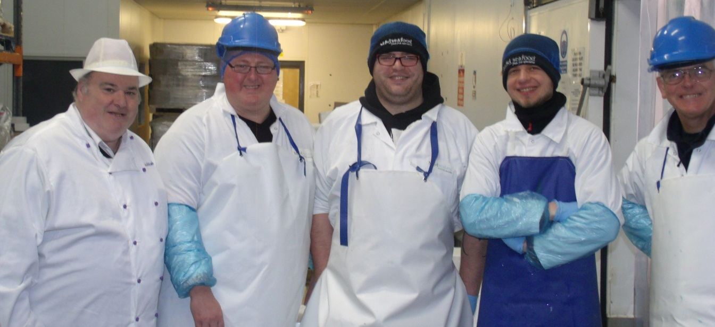
Why are things better now?
Employers are more enthusiastic
Fish friers
Fishmongers
Processors

Slide 11
Why are things better now?
Fish and shellfish standards are used to:
Underpin qualifications and apprenticeships
Guide development of training courses and qualifications
Promoting proficiency not just competence
Developing skills and knowledge
Within and outwith the business.

Slide 12
Fish and Shellfish Industry Skills
a closer look
Notes:
Lee Cooper, Seafish and the Seafood Training Academy email academy@seafish.co.uk

Slide 13
Fish and Shellfish Proficiency Qualifications
Level 2 Fish/Shellfish Award, Certificate and Diploma
Level 3 Fish/Shellfish Certificate and Diploma
What do we need to know?
Structure
Scope and available units
Fish content
Mixing and matching (rules of combination)

Slide 14
Structure
Four types of unit
Carry out
Understand how
Principles of
Demonstrate
Each unit has
Credit value
GLH
Learning outcomes
Assessment criteria
Notes:
More about this tomorrow in the practical workshop.

Slide 15
Scope
Bivalve purification, processing, manufacturing, retail, fish frying
Managers, supervisors, team leaders and operatives
80% commonality with other F&D standards
Compliance
Sales
Problem resolution
Packaging and labelling
Quality, waste management
Notes:
These include compliance functions like food safety and health and safety; operative functions including fish and shellfish processing, sales, problem resolution and specific functions like packaging and labelling.

Slide 16
Available units
 | Level 2 | Level 3
Fish and Shellfish Units | 53 | 24
Other Units | 109 | 83
Total Units | 162 | 107
Total Credits | 387 | 308
 | Level 2 | Level 3
Occupational Skills | 78 | 48
Occupational Knowledge | 74 | 39
Underpinning Knowledge | 10 | 20

Slide 17
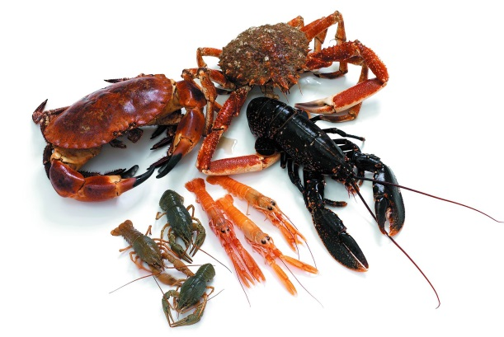
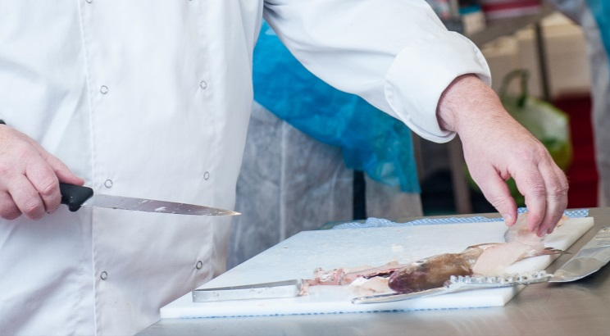
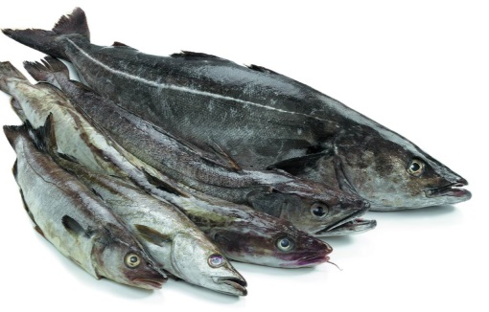
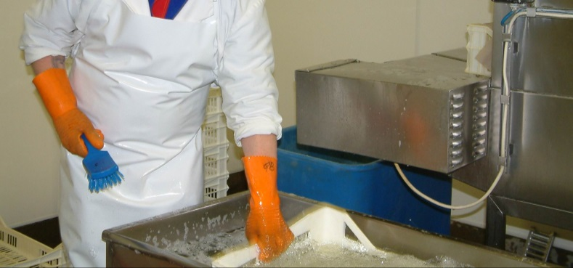
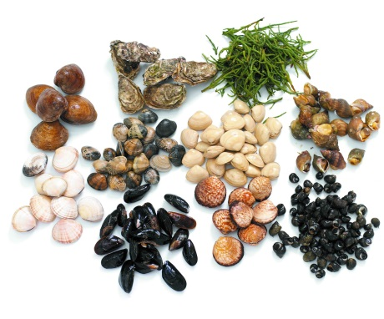
Fish Content
53 Level 2 units
24 Level 3 Units
Covering
Filleting
Shucking
Smoking
Packing in ice
Live shellfish
Depuration
Frying
Gutting
Skinning
Etc.

Slide 18
Rules of Combination (pt1)
For UK qualifications
Size
10 credits for an Award
27 credits for a Certificate
37 credits for a Diploma
Notes:
Level 2
Award – no UK Units
Certificate – 21+ credits from OS/OK and up to 7 credits UK
Diploma – 22+ credits from OS/OK and up to 15 credits UK
Level 3
Certificate – 17+ credits from OS/OK and up to 10 credits UK
Diploma – 22+ credits from OS/OK and up to 15 credits UK

Slide 19
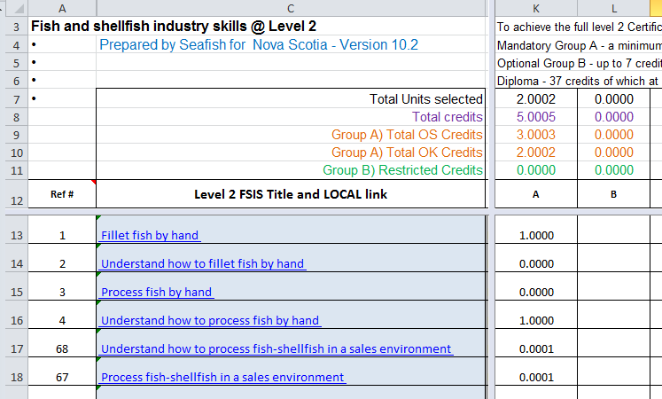
Rules of Combination (pt2)
No mandatory units
No requirement to match skill with knowledge
Level 2 qualifications can include some Level 3 units
A bewildering array of choice

Slide 20
Skills Diagnostic Workshop
Review of qualifications and units
Closer look at Unit structure
Using the diagnostic spreadsheet
Matching selections of units to
A business
A department
Individual job roles
Producing a bespoke qualification plan

Slide 21
Why Diplomas and Certificates?
Certificates
Underpin apprenticeships
Apprenticeships are funded;
Substantial and recognised;
Diplomas
A challenge
For when certificates are just too small
Almost all Level 3 apprentices undertake diplomas
Awards
Disappointing take-up

Slide 22
Why the need?
An ageing workforce?
Aid to recruitment?
Professional qualification?
Raising standards of performance?
Promote take-up of training?
Other benefits / uses of the standards?
Notes:
Our workforce has been ageing for 20 years at least.
The existence of apprenticeships does improve the perception held by many of the value of our industry.
Some individuals (Steve and Gaynor) value the Diploma as a professional qualification.
Raising Standards – an effective method for a business, not just the apprentice.
Promote the take up of training – an opportunity to access funding for training without undermining the principle that the business should pay. Businesses generally benefit from having an apprentice.

Slide 23
Conclusion
Fish and Shellfish Industry Skills Proficiency Qualifications
Flexible
Comprehensive
Scalable
Fit for purpose
Bite sized
Effective
Well received by employers.

Slide 24
How can this benefit your business?
Implementing training, staff development, apprenticeships can…
Improve job satisfaction
Reduce staff turnover and absenteeism
Improve recruitment success
Improve productivity and quality, reduce waste
even amongst experienced employees
When implemented effectively.
We no longer carry out studies to demonstrate this
Notes:
Studies in the past have been costly and complex to implement, but have shown that an effective programme, delivered with a clear vision of what is required will yield positive results.
“you have asked what it will cost and what the benefits are. I don’t know and I haven’t carried out an analysis. It will cost what it costs and the more we invest in this the greater our returns will be, so the question we need to answer is how much we want to invest in this?” Factory general manager around 2001 to his Board of Directors.

Slide 25
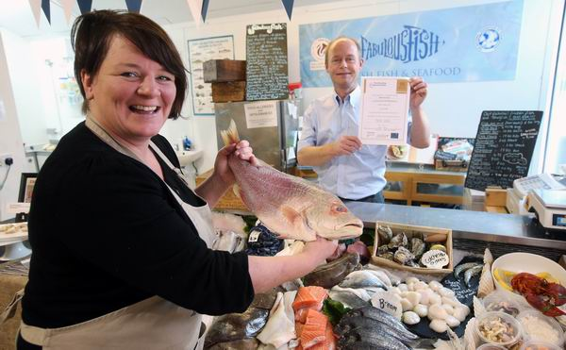
Fish and Shellfish Industry Skills
Not just competent, but proficient !

Slide 26
Questions?

